Slide 1

Books Shop listing app
Ashwin Thonoor
Brundha Prabhudeva
Sirisha Varanasi
Umme Hanee
Sumit Kesarvani

Slide 2
INTRODUCTION
We have developed a book app website with name ABS2U
This website consists of two modules
User
Admin
User: It has the access to books in our database, and can buy them
Admin: It has the access to modify, delete and add books

Slide 3
TECHNOLOGIES
Git
Spring Boot
Docker
MySQL
Thymeleaf
Jenkins
Nexus

Slide 4
GIT
Git is a popular version control system
Manage projects with Repositories
Pull the latest version of the project to a local copy
Push local updates to the main project

Slide 5
SPRING BOOT
Spring boot is a module of the spring framework which is used to create stand-alone, production-grade Spring based Applications with minimum programmer’s efforts.
We run and use it as a web app

Slide 6
DOCKER
Docker is an open-source containerization platform, designed to simplify the process of application packaging, deploying, and running by using containers.
It converts the code into an image so that it can run anywhere, irrespective of the system settings and the environment.

Slide 7
MySQL
MySQL is a relational database management system
It is open-source, free and ideal for both small and large applications
It is used for storing and retrieving data.

Slide 8
MongoDB
One of the most popular NoSQL database(Non-relational) is MongoDB
It is used for storing data in key-value pair form

Slide 9
THYMELEAF
It is a server-side java template engine that is used to create web applications
It extracts values from our repository and displays them dynamically
It helps to reduces the code by elimination repetition.

Slide 10
JENKINS
Jenkins is a powerful application that allows continuous integration and continuous delivery of projects, regardless of the platform you are working on
It's a build management tool

Slide 11
NEXUS
Nexus is a repository management tool
We can store the project artifacts in repositories and maintain it.

Slide 12
Login
User page
Admin page

Slide 13

User Operation
Landing page
Login
Registration
Home
Available
Books

Slide 14
Available books
Buy now
Add to cart
Payment
Receipt
Confirmation
Home

Slide 15
Admin Operation
Landing page
Login Page
Admin Table
(CRUD)

Slide 16
Mongo DB
Book Details
Team Members

Slide 17
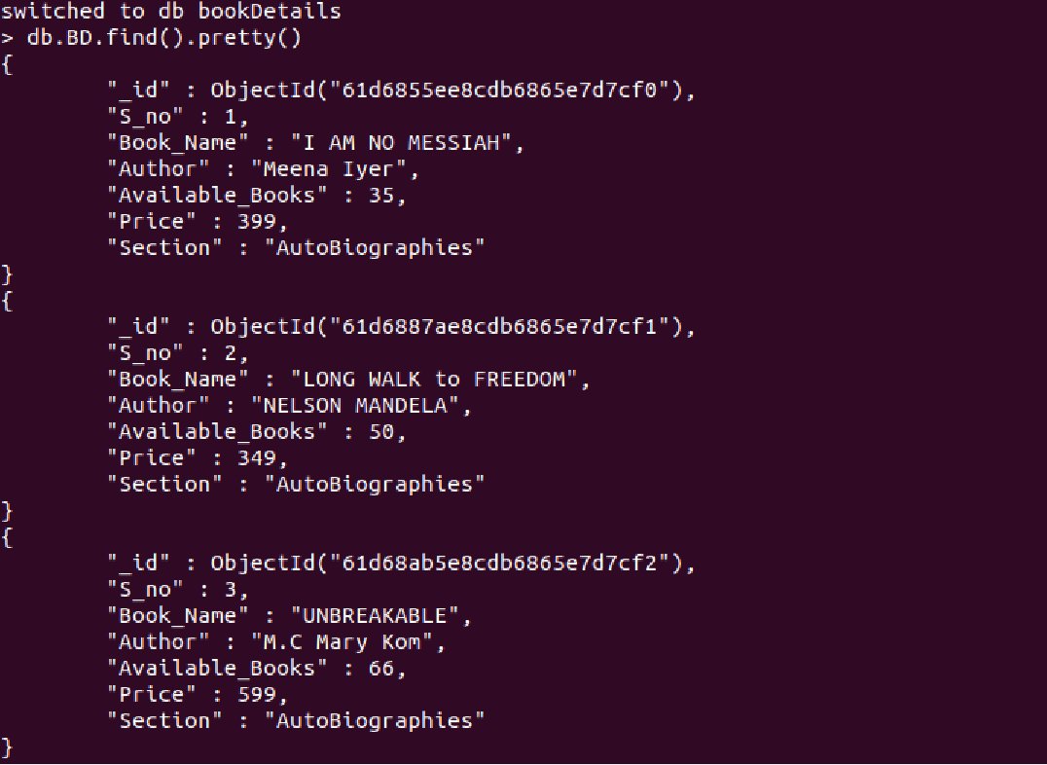
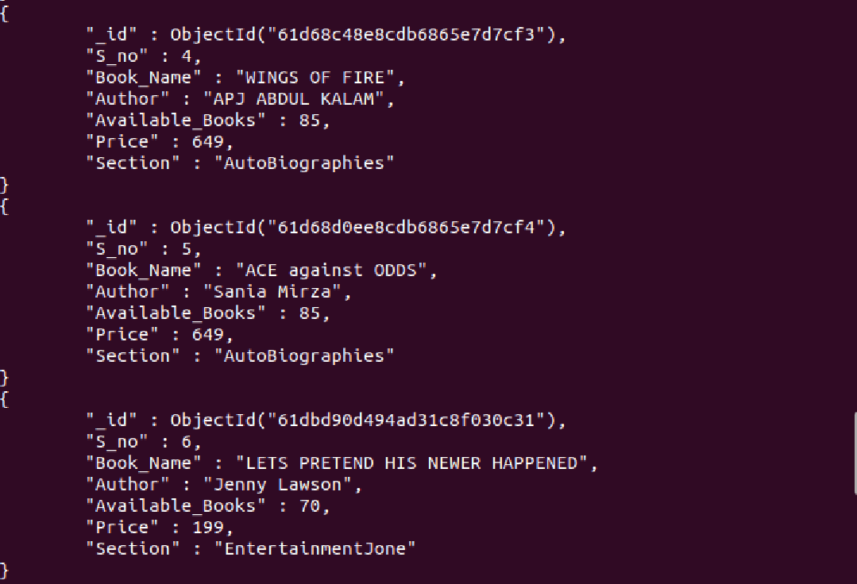
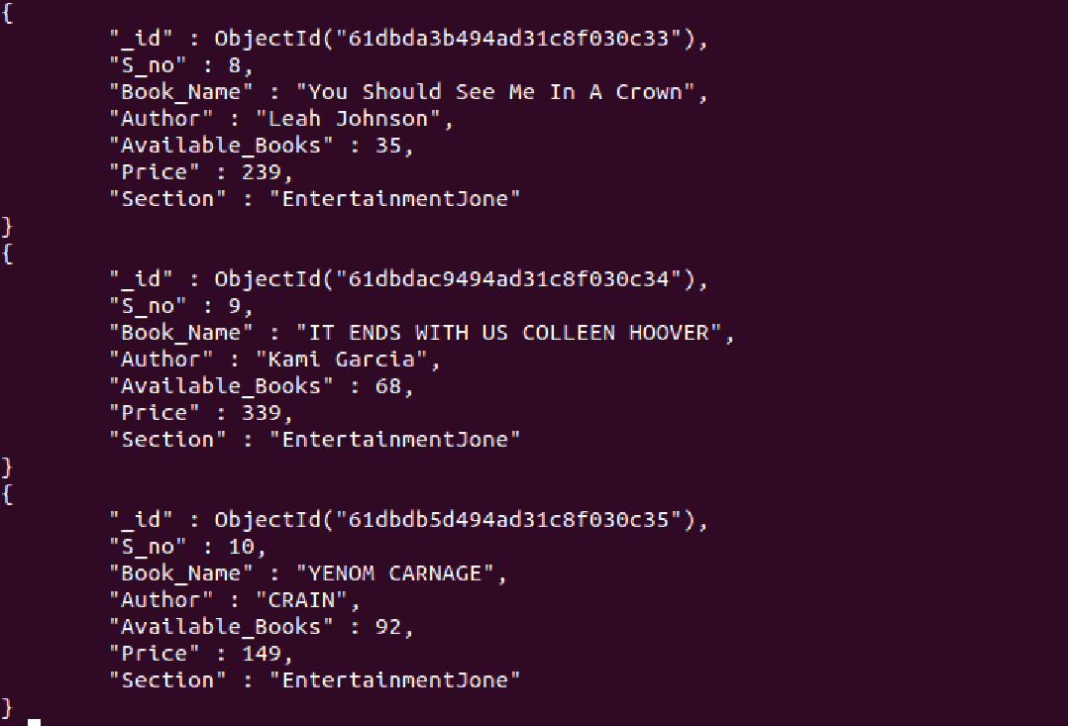
Book Details

Slide 18
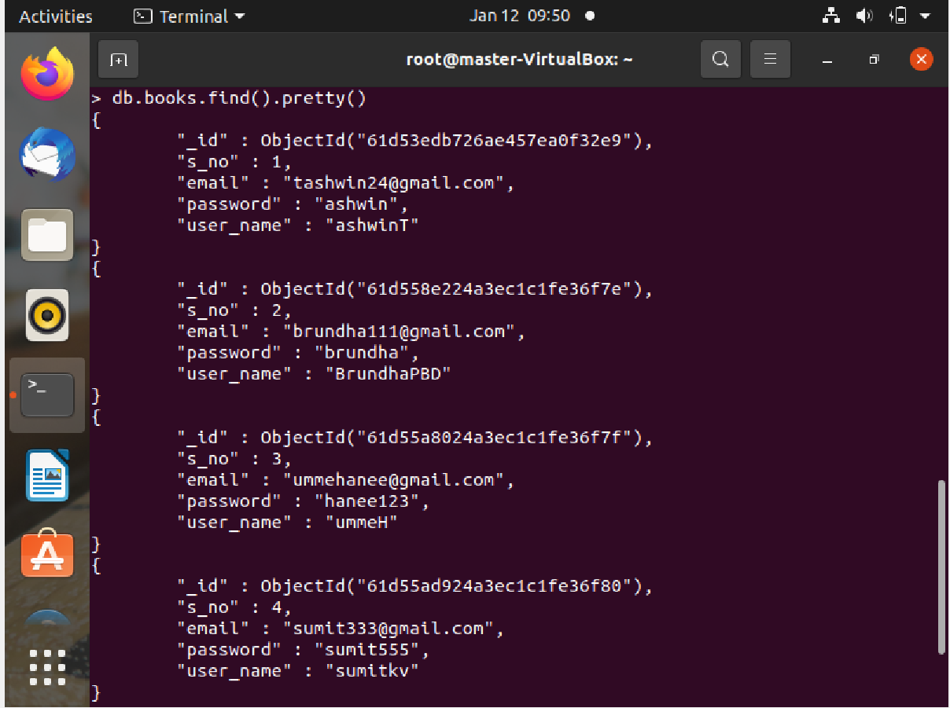
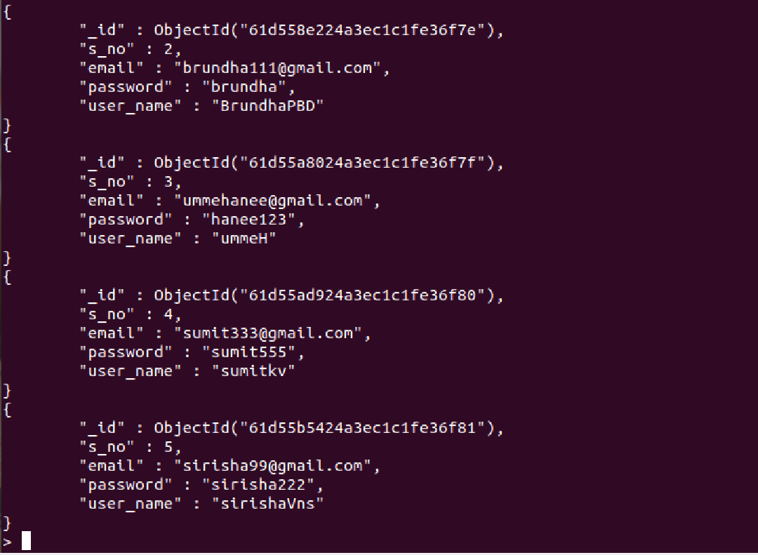
Team Members Details

Slide 19


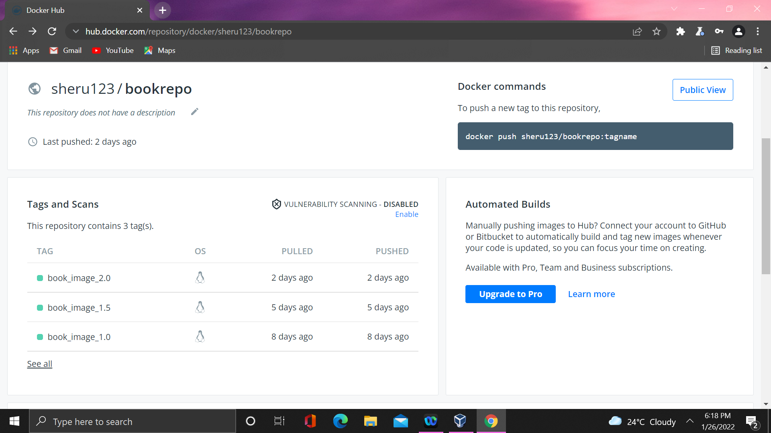
Docker
3 version of our project has been dockerized.
Latest version 2.5, our final version.

Slide 20
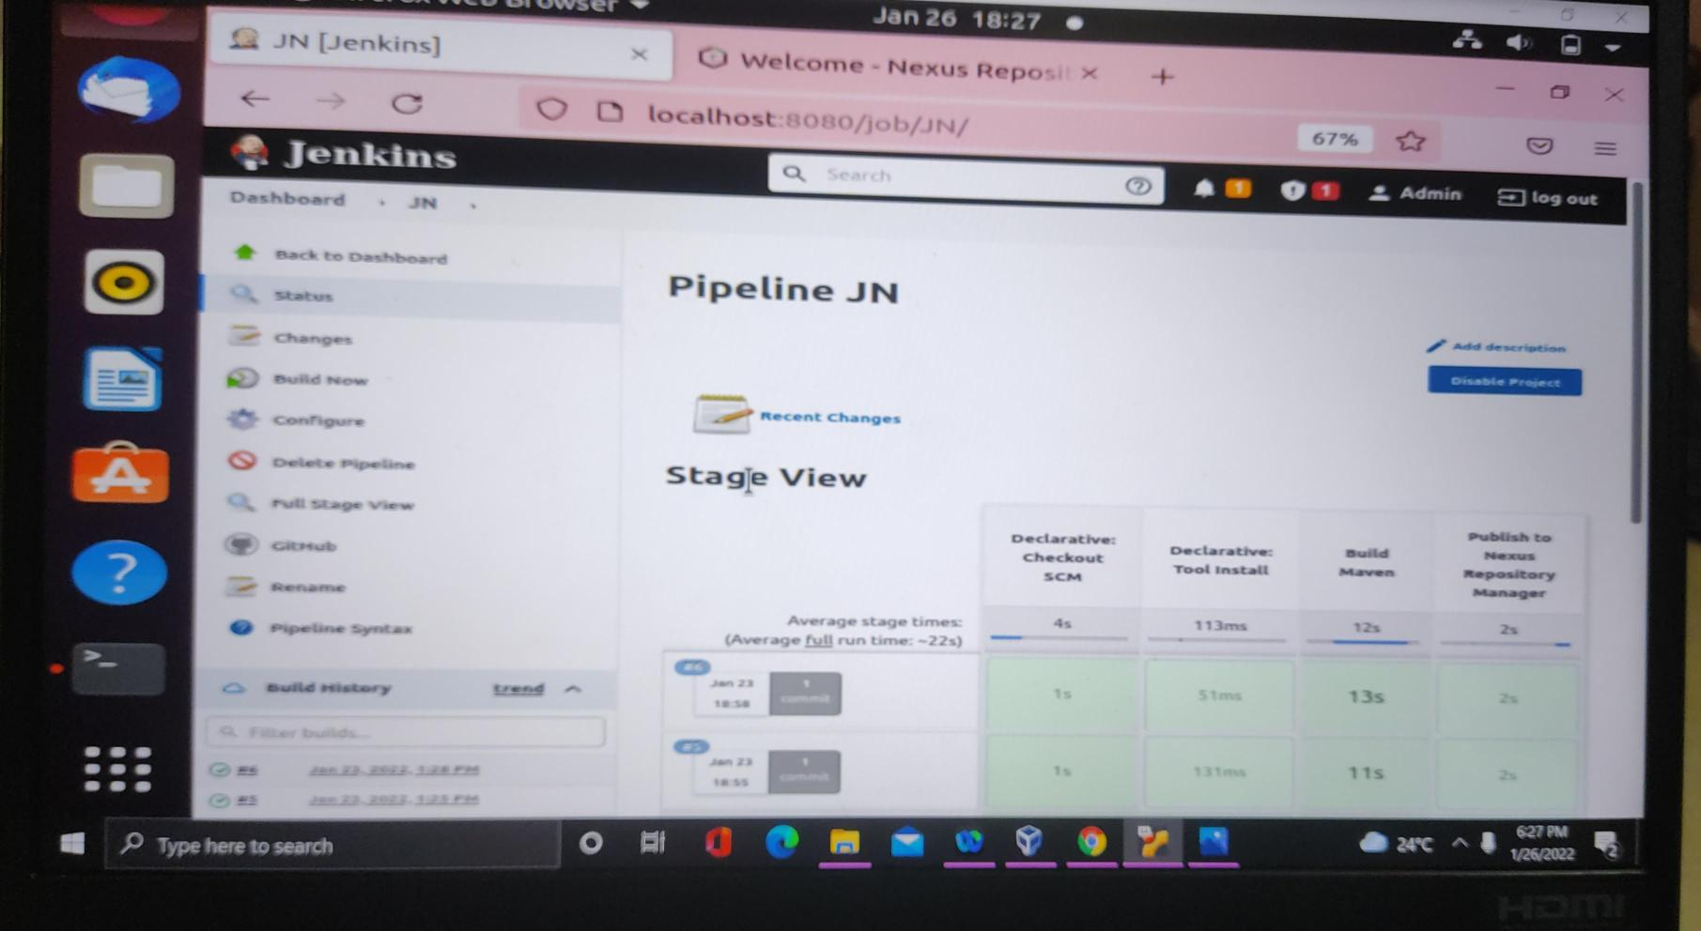
Jenkins
We have implemented the auto-commit build using jenkins in our project.
It also creates maven artifact and uploads it to nexus repository.

Slide 21
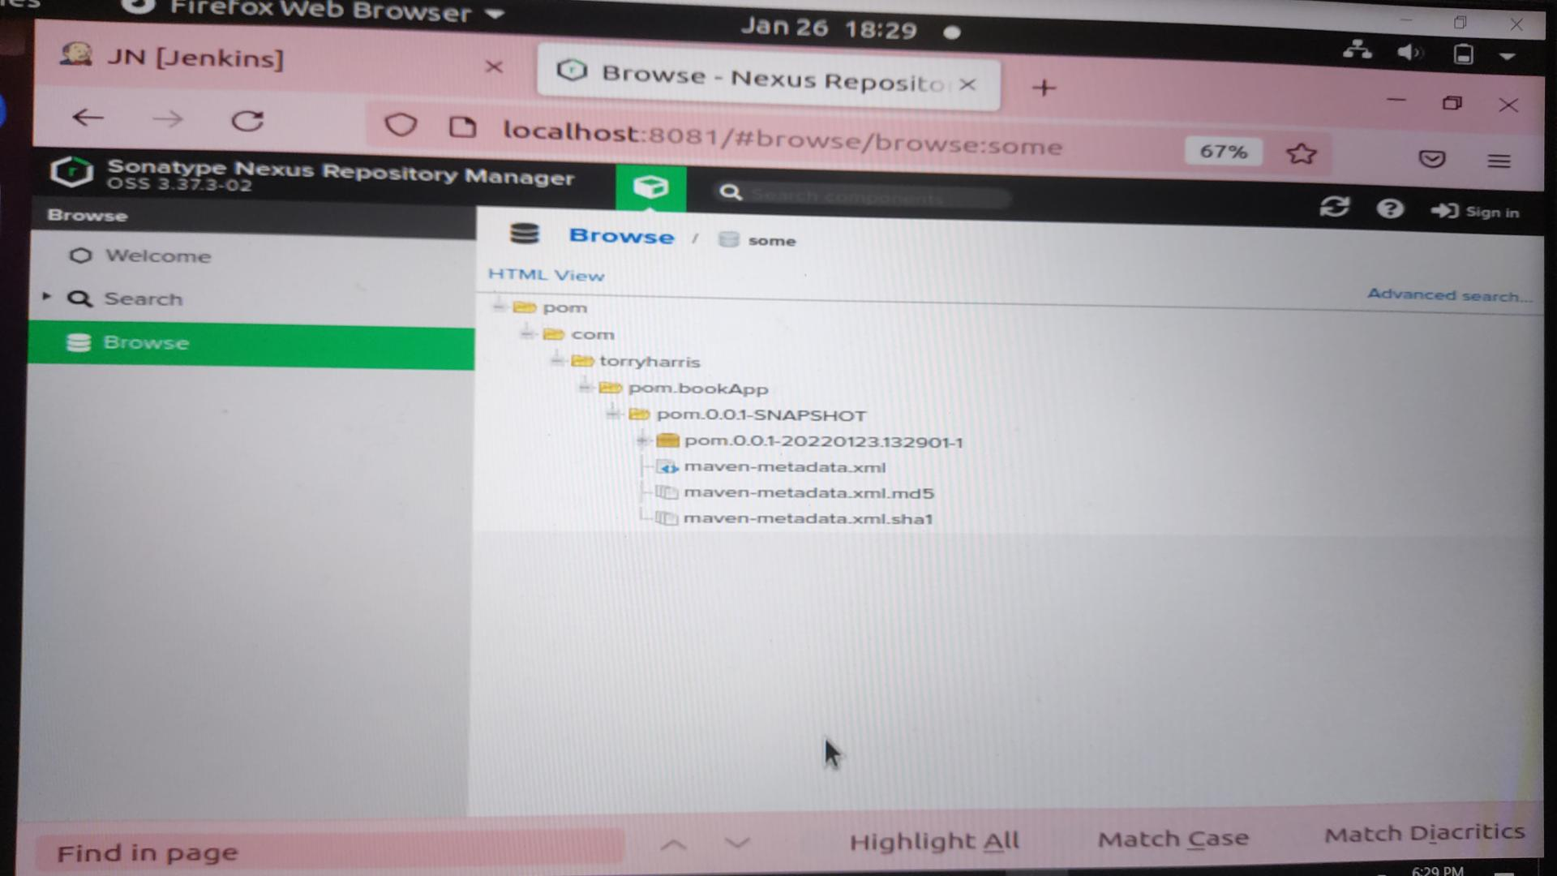
Nexus
Artifact is stored in our nexus repository.

Slide 22
Agile Process

Slide 23
Product Backlog
Login and Registration page.
Home Page.
Available Books Table.
Cart Page.
Cart Page calculation.
Payment.
Confirmation Page.
Receipt Page.
Admin Page.
Admin Operations.

Slide 24
Sprints
Sprint 1:
Login and Registration page.
Home Page.
Sprint 2:
Available Books Table.
Admin Table.
(Ashwin, Brundha) 3
(Umme Hanne, Sirisha, Sumit) 5
(Ashwin, Brundha) 3
(Ashwin, Brundha) 3

Slide 25
Sprints
3. Sprint 3:
Admin Table, Available Books.
Cart.
Jenkins.
4. Sprint 4:
Jenkins, Nexus.
Cart, Cart page calculation.
(Ashwin) 4
(Brundha) 3
(Umme Hanne) 3
(Umme Hanne) 3
(Ashwin, Sirisha) 4

Slide 26
Sprints
5. Sprint 5:
Docker
Mongo DB
Confirmation Page, Payment
6. Sprint 6:
PPT
Landing Page
(Umme Hanne) 4
(Sumit) 4
(Ashwin, Brundha) 2
(Sirisha, Sumit) 3
(Ashwin) 2

Slide 27
Sprints
7. Sprint 7:
Receipt Page
PPT
(Ashwin) 2
(Sirisha, Sumit, Ashwin) 2

Slide 28
Thank you

